Slide 1

Deep Neural Networks
Gates
Reference: www.deeplearningbook.org
Chapter 6

Slide 2
Introduction
Neural Networks = Deep Neural Networks = Multilayer perceptrons = Deep Feedforward NN
For simplicity, let’s use NN to describe any feed forward, multilayered, network.
A NN defines a mapping y = f(x, P), where P are the parameters and the NN learns the values of the parameters to offer the best function approximation.
Feed forward → information flows through the function without any feedback.

Slide 3
Applications of NN
1) CNN are used for object recognition in photos
2) RNNs are used for NLP

Slide 4
Networks – function composition
A function f(x) can be composed of other functions:
Example
f(x) – h ( g ( f ( x)))
This type of composition is a CHAIN.
NN’s use this chain structure such that f is the first layer, g is the next layer, and so on.
The length of the chain gives the depth of the NN.

Slide 5
Inputs and Outputs
Given y = f(x)
y is the label
x is a “training point” (a vector or row in the dataset associated with the label y)
f is the function that associates the rows (vectors) of data with the labels y.
The goal of a NN is to approximate f so that it can generate the expected label for a given data vector (point).
The values of the vector x are the inputs.
A dataset with 100 rows will have 100 vectors that will be fed into the NN.
The final layer of the NN (in the chain) is the output layer.
Labeled data is required to train a NN.
One labeled data row (vector) provides one training example:

Slide 6
Hidden Layers
In a NN, the input is a vector x (a row of data x1 , …, xn) from a dataset.
The output should be the label expected for vector x.
However, the other “layers” of the NN are not specified by the training data.
The learning algorithm must decide how to use the layers to produce the desired output.
Therefore, the inner layers are called, hidden.
Finally, the networks are called “neural” because they are inspired by neurons.
Each “unit” in a hidden layer will receive input and will offer output (via an activation function).

Slide 7
Aspects of NN
As we progress through all the details of NNs, we will specifically look at:
1) Activation functions
2) Weights, Vectors, and Feedforward
3) Hidden Layers and how inner and final outputs are created – network architecture
4) Loss functions
5) Updating weights (with Loss functions) via partial derivatives (gradient descent).
6) Back Propagation and the Chain Rule for function composition (more partial DE)

Slide 8
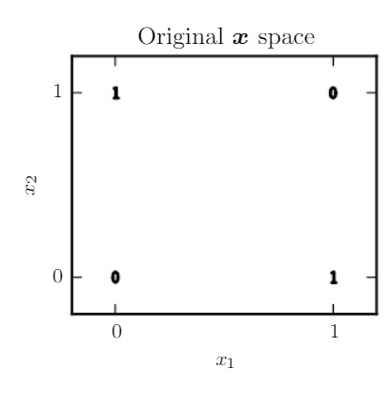
Example: Learning XOR with a NN
XOR has two inputs, say x1 and x2.
When x1 and x2 are either both 0 or both 1, the output is 0. Otherwise, its 1.

Slide 9
Goal of Predicting XOR
1) XOR has a TARGET function y = f*(x) that we want to LEARN.
2) Our goal is to have our model provide a function y_ = f(x, P), where P represents the parameters, so that the algorithm ADAPTS the parameters to make f as similar as possible to f*.

Slide 10
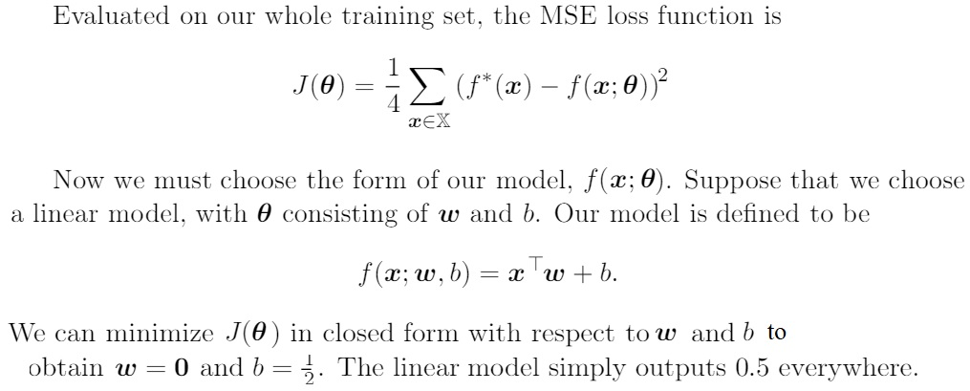
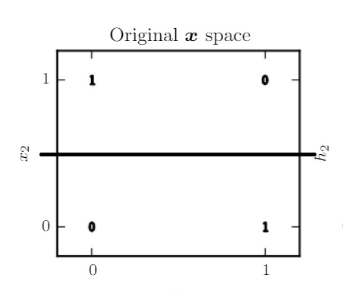
Can Linear Regression Predict XOR?
[ 0 0 ] → 0 ?
[ 0 1 ] → 1 ?
[ 1 0 ] → 1 ?
[ 1 1 ] → 0 ?

Slide 11
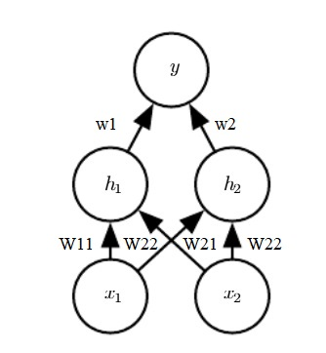
Feedforward NN with one Hidden Layer

Slide 12
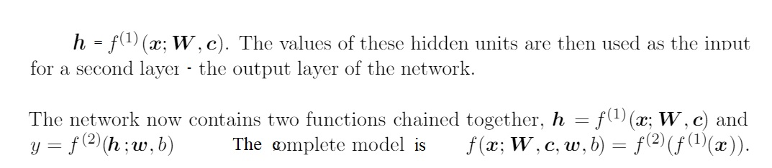
Details of the NN with one Hidden Layer

Slide 13
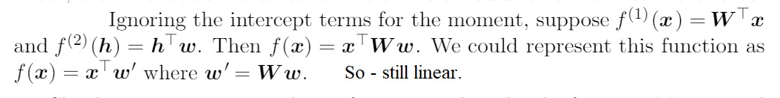
Can f(1) (x) be Linear?

Slide 14
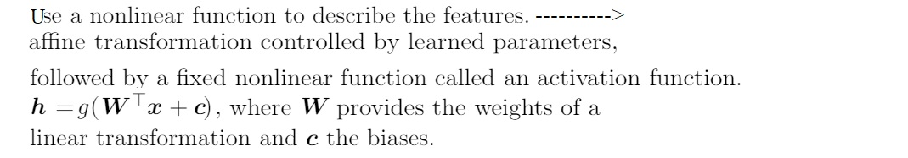
Affine Transformation + Activation Function

Slide 15
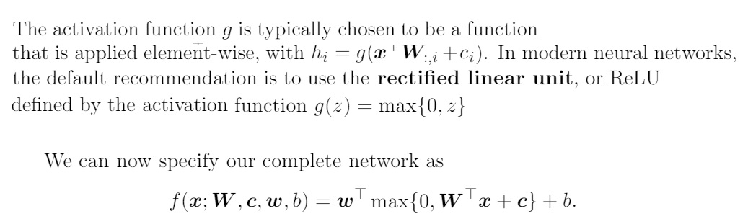
Activation Function and Final Network

Slide 16
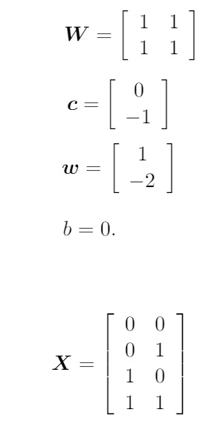
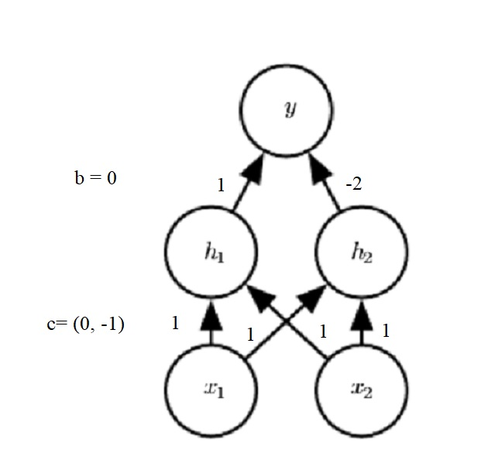
Solution for XOR
Activation Function g is:
max {0, z}
g((x1)(w11) + (x2)(w21) + 0) = h1
g((0)(1) + (0)(1) + 0) = h1 → 0
g((0)(1) + (0)(1) + -1) = h2 → 0
y = g((0)(1) + (0)(-2) + 0) →0
g((0)(1) + (1)(1) + 0) = h1 → 1
g((0)(1) + (1)(1) + -1) = h2 → 0
y = g((1)(1) + (0)(-2) + 0) → 1
Notes:
X1 = 0, x2 = 0; x1 = 0 , x2 =1

Slide 17
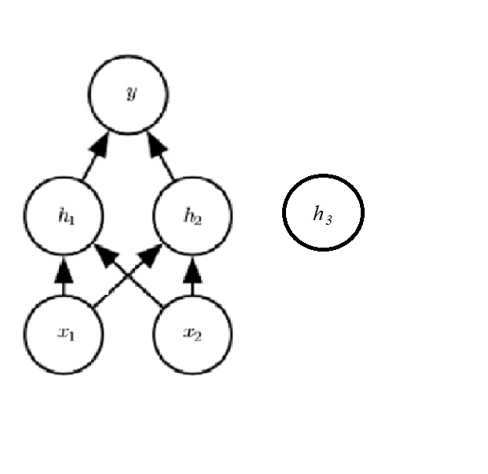
Getting the Shapes Right – with 3 hiddens
x11 x12
x21 x22
x31 x32
x41 x42
h1=(x11)(w11) + (x12)(w21)
h2=(x11)(w12) + (x12)(w22)
h3=(x11)(w13) + (x21)(w23)
w11 w12 w13
w21 w22 w23

Slide 18
Exercise: Code this Small NN for XOR in Python
Work as a team

Slide 19
Solution – Easy XOR - NN (no back prop)
https://drive.google.com/file/d/1tdoT0TRrcjE8W0UC7Uk6-CJPr0pk8dEm/view?usp=sharing

Slide 20
Adding Weight Improvement (Training) to the NN with Gradient Descent
1) The non-linear nature of NNs creates non-convex loss- functions.
In English ☺ this means that we cannot simply take the derivative, set it to 0, and solve for the min or max. Instead, we will TRAIN our NN models using “iterative gradient-based optimization”.
The goal is to drive the cost function to a very low value.
2) It is possible to arrive at a local (rather than global) extrema.
3) Convex optimization converges starting from any initial parameters.
4) However, when we apply stochastic (random) gradient descent to a nonconvex loss function, there is NOT a convergence guarantee and the method is affected by the initial parameters.

Slide 21
Initialization and Training
1) For NN, because we will use stochastic gradient descent, it is important to initialize weights to small random variables.
2) The biases may be initialized to 0 or small random variables.
3) Training - use a gradient to descend the cost function.
4) Therefore, a first step in Training a NN is selecting a COST FUNCTION.

Slide 22
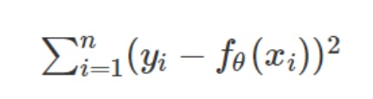
Cost Functions /Loss Functions
More general - define an objective function to optimize.
Examples:
- Maximize the posterior probabilities (e.g., naive Bayes) - Maximize a fitness function (genetic programming) - Maximize the total reward/value function (reinforcement learning) - Maximize information gain/minimize child node impurities (CART decision tree classification) - Minimize a mean squared error cost (or loss) function (CART, decision tree regression, linear regression, adaptive linear neurons, … - Maximize log-likelihood or minimize cross-entropy loss (or cost) function
A cost/loss function is a measure of error between what value your model predicts and what the value actually is.
Cost and loss functions are synonymous and some people also call it error function.

Slide 23
Which Cost/Loss Function
Loss function is a method of evaluating “how well your algorithm models your dataset”.
If your predictions are totally off, your loss function will output a higher number.
If they’re pretty good, it’ll output a lower number.
As you tune your algorithm to try and improve your model, your loss function will tell you if you’re improving or not.
‘Loss’ helps us to understand how much the predicted value differ from actual value.
RE: https://medium.com/@zeeshanmulla/cost-activation-loss-function-neural-network-deep-learning-what-are-these-91167825a4de

Slide 24
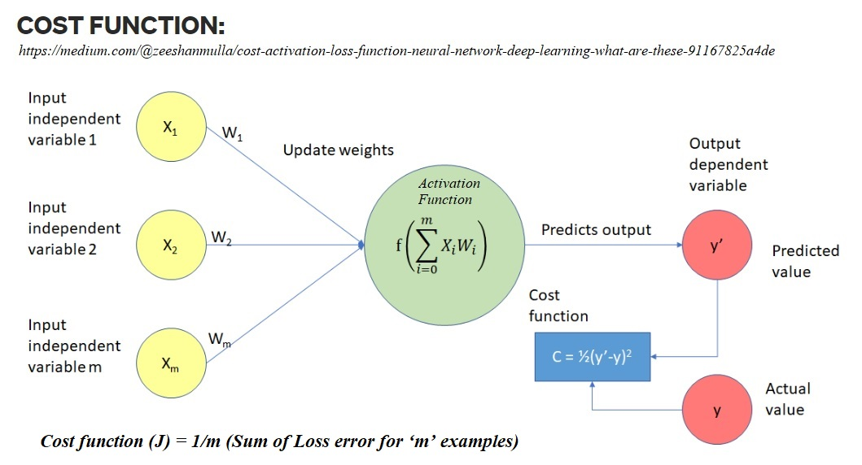

Slide 25
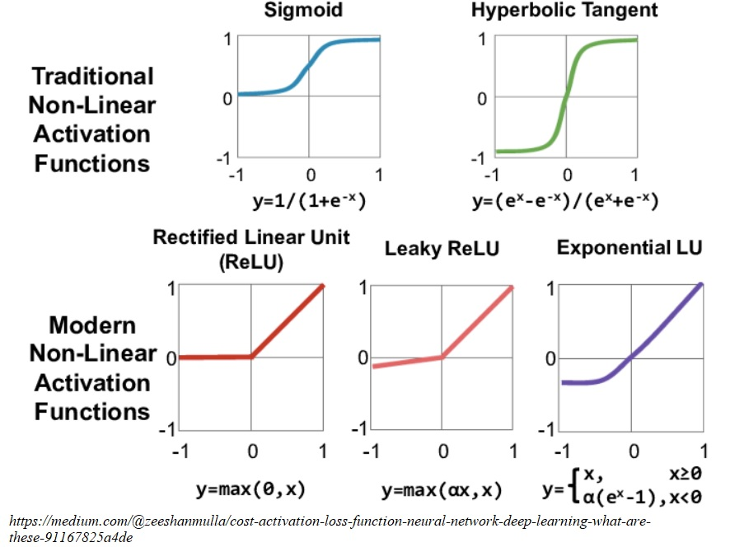
Reminder: Activation Functions

Slide 26
Non-Linear Activation Functions
Deep learning improved significantly due to the use of non-linear activation functions.
Most modern neural networks use the non-linear activation functions because they allow the model to create complex mappings between the network’s inputs and outputs.
This is essential for learning and modeling data such as images, video, audio, and data sets which are non-linear or have high dimensionality.

